Slide 1



RETAI L DATA ANALYSI S
Presented by
Kavya Boban UID - 223811

Slide 2



INTRODUCTION
People tend to buy more things before a festive season than during a normal, non-holiday week. So the revenue earned by the shop can increase if there is a good estimate about the seasons that can give a profit and plan accordingly.

Slide 3



PROJECT DESCRIPTION
The proposed system can therefore be used in order to optimize the production of products, such that there is always an optimal amount available. The proposed system can be used by shops in order to better predict the number of products, that might get sold and therefore to better estimate how much product should be produced.

Slide 4
RELEVANCE OF THE PROJECT
The organization can easily predict the weekly sales of a store.
visualize the data for better insight.
This should then help to optimize the manufacturing process and thereby help to increase income while lowering costs.

Slide 5


DATASET
1. Stores
Anonymized information about the 45 stores, indicating the type and size of store.

Slide 6
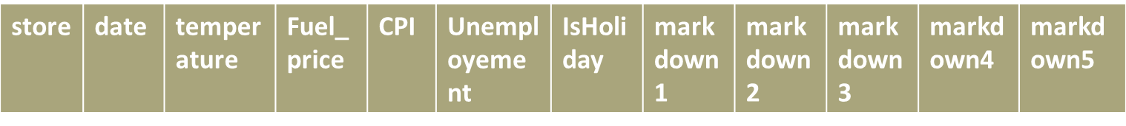

DATASET
Features
Contains additional data related to the store, department, and regional activity for the given dates.

Slide 7

DATASET
Sales
Historical sales data, which covers to 2010-02-05 to 2012-11-01. Within this tab you will find the following fields:

Slide 8
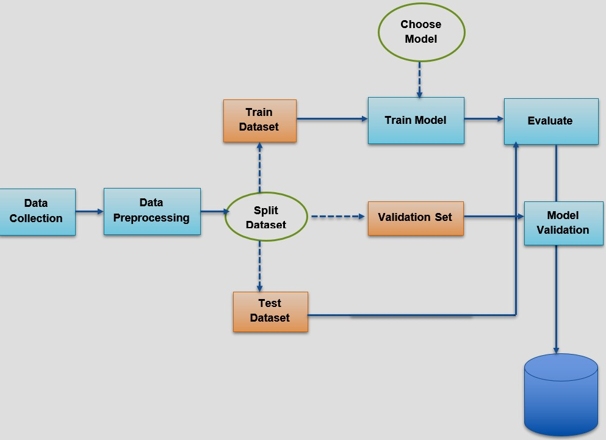

MODULES
Data collection
Data preprocessing
Visualization
Test and train spliting
Model training
Evaluation\ validation

Slide 9

ALGORITHMS USED
Linear Regressor
Random Forest Regressor Decision Tree Regressor XGBoost Regressor

Slide 10
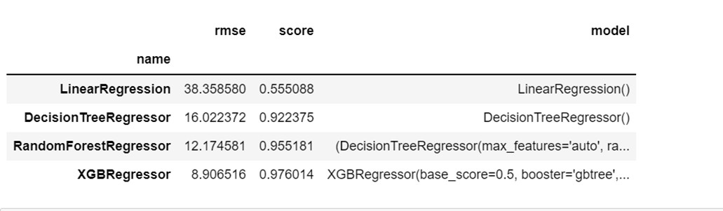


Slide 11
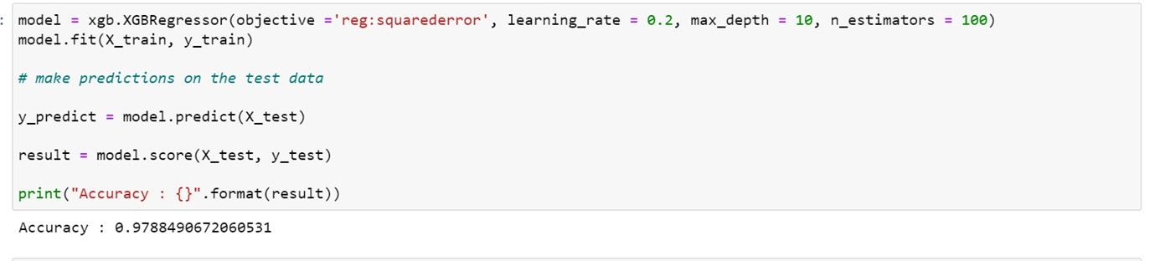

ACCURACY

Slide 12
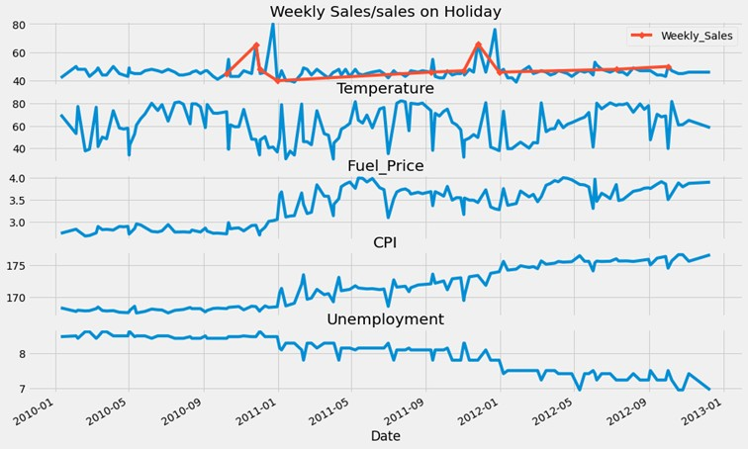

VISUALIZATION
Nov- Dec shows spike in Weekly Sales.but over the year it is not increased.
weeks nearby holiday shows peak
Fuel Price and Consumer Price shown growth over the year.
Index
Unemployment decreased year after year.
Temperature is showing a random walk

Slide 13
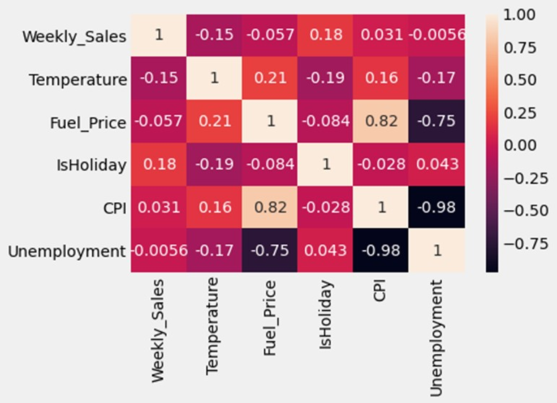
Weekly sales don't show any high correlation with any other parameters.
CPI and Unemployment shows a negative correlation on the other hand Fuel Price show a positive correlation
Unemployment and Fuel price are also negatively correlated

Slide 14
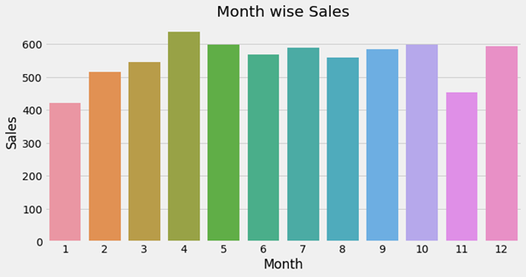
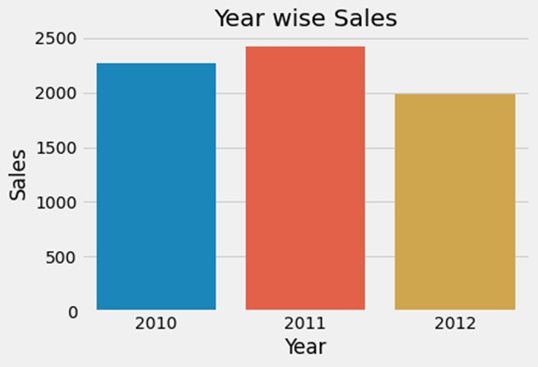

It could be as Enough buying during offers and holidays (Black Friday Sales,Chrismas, New year) and later sales go down and then again gaining momentum in some months.
In Nov also people show less buying can be waiting period for upcoming sales.
whole data for Dec-2013 I guess is not available so even after spike in Dec the sales are not gone very high.

Slide 15
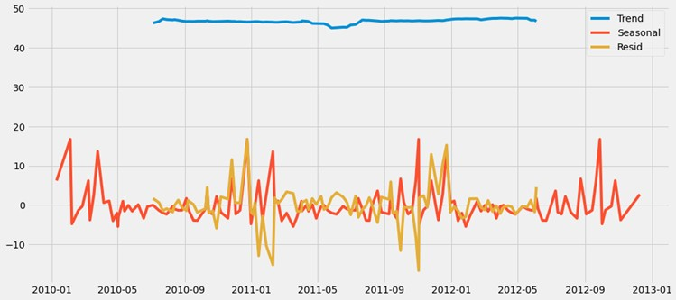
It shows a sideway trend

Slide 16
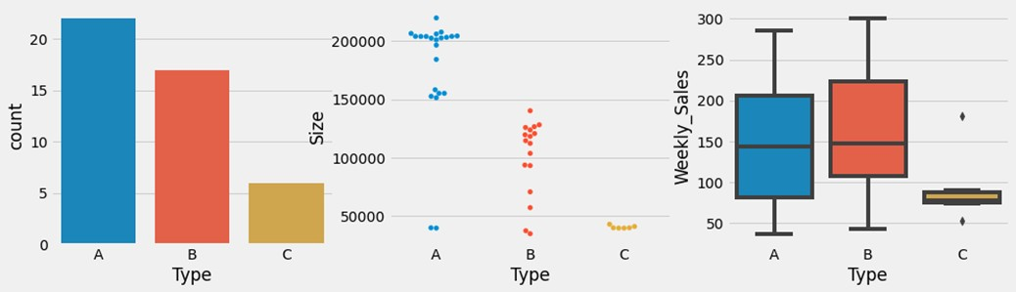
Store Count is in the order of A, B and least is C
Size wise A store as most no of Item followed by B and than C
Even After less Count of Store and lesser Size B has more Weekly Sales than A and C at the least

Slide 17

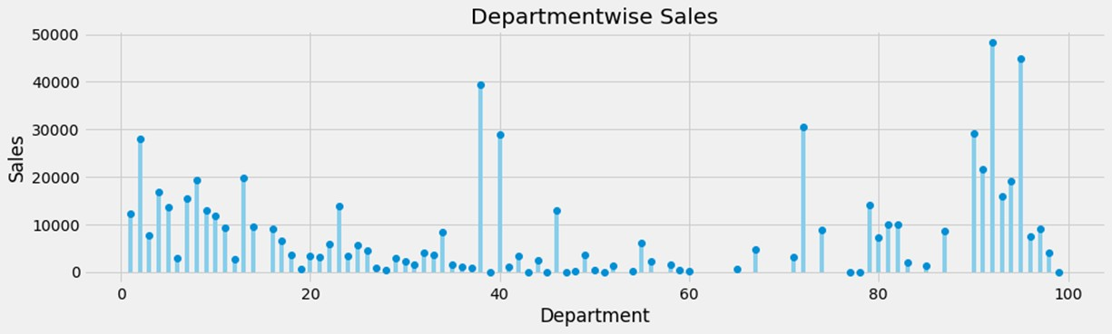
Here we can see department 1-15 as well as 90-95 has shown higher weekly sales.
some department as 38,40,72 has shown higher weekly sales.

Slide 18
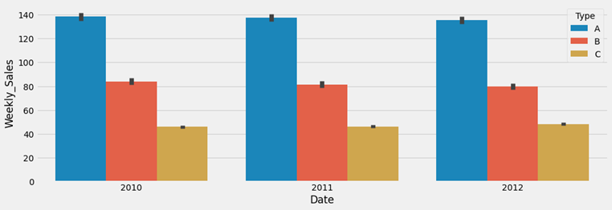
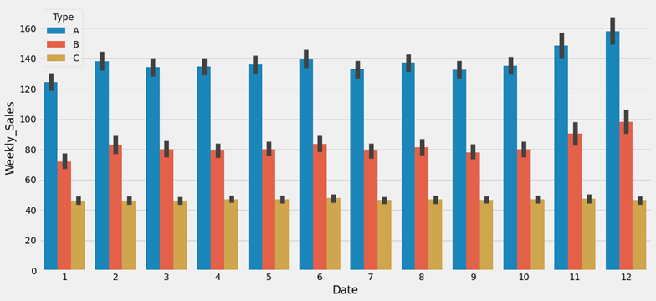
Store Type A & B has shown a slight decrease year on basis of sales.
Store C has shown a slight increase in sales.
Type A & B store shows a spike in Nov Dec mostly due to holiday whereas Jan has shown a decrease in the sale.
Type C is consistent over every month and doesn't show much deviation

Slide 19

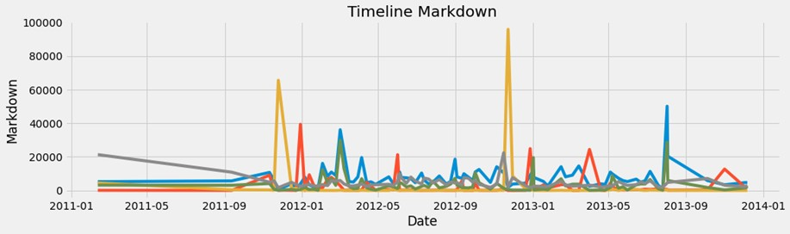
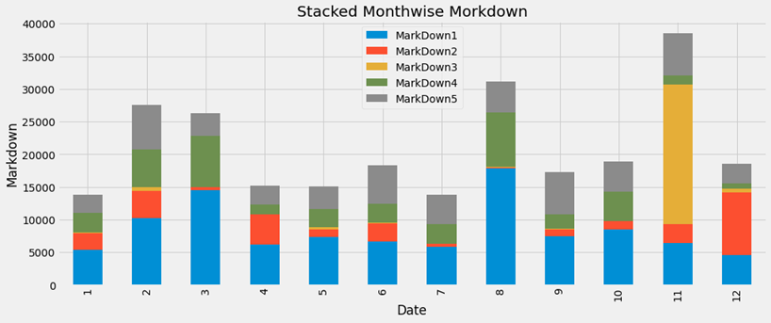

Slide 20
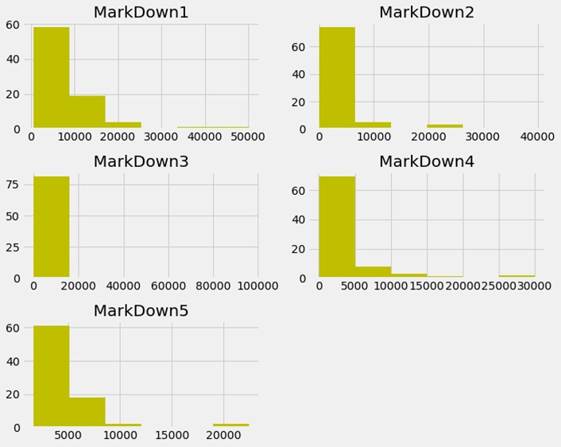
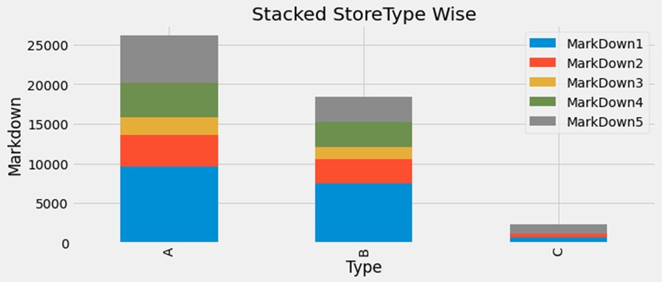


Slide 21
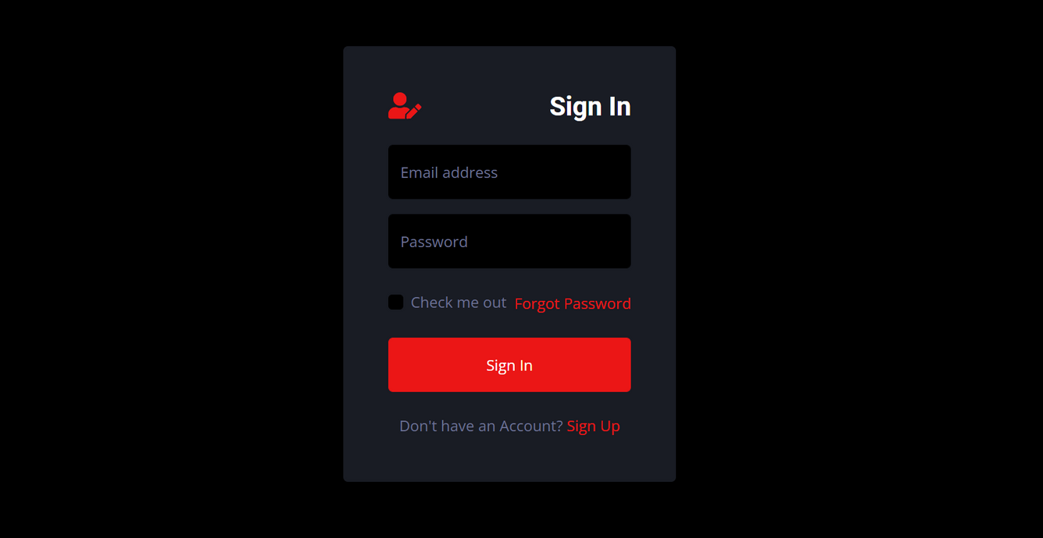
UI- website

Slide 22
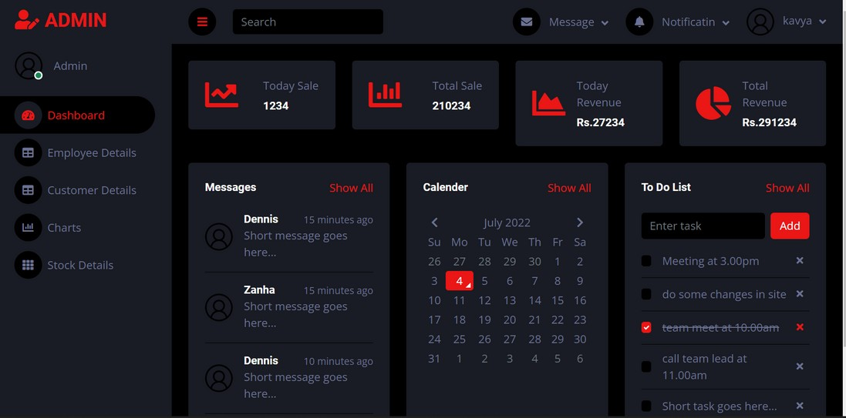
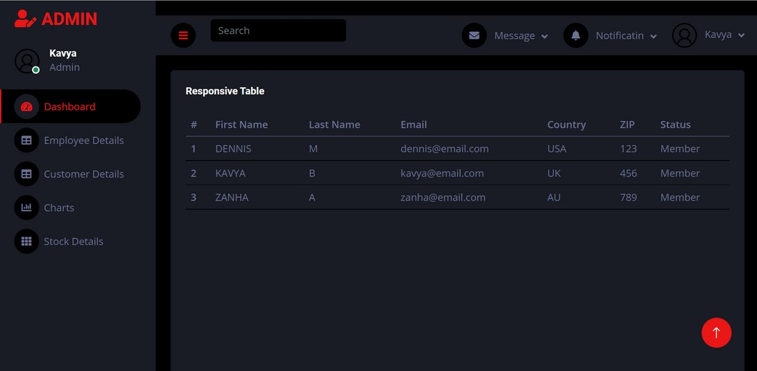
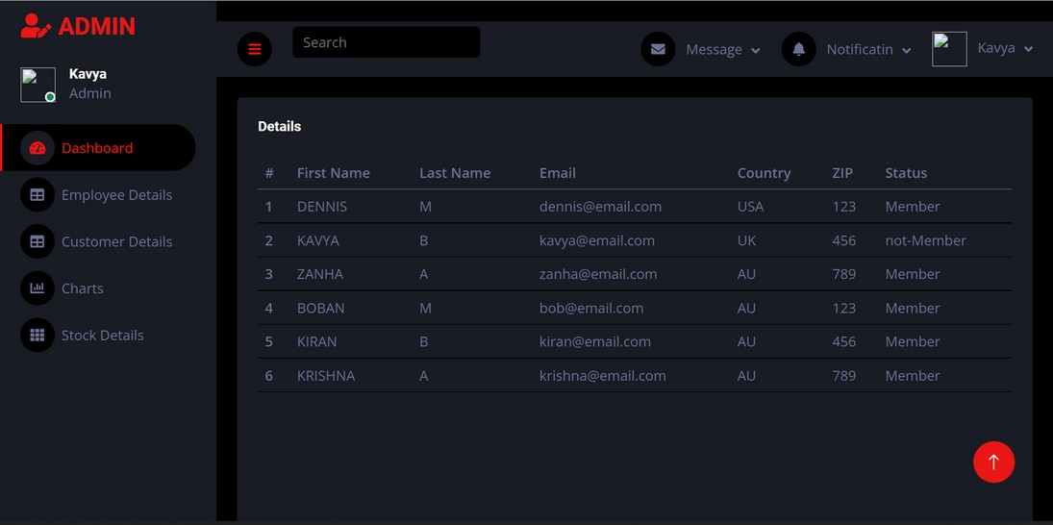

Slide 23
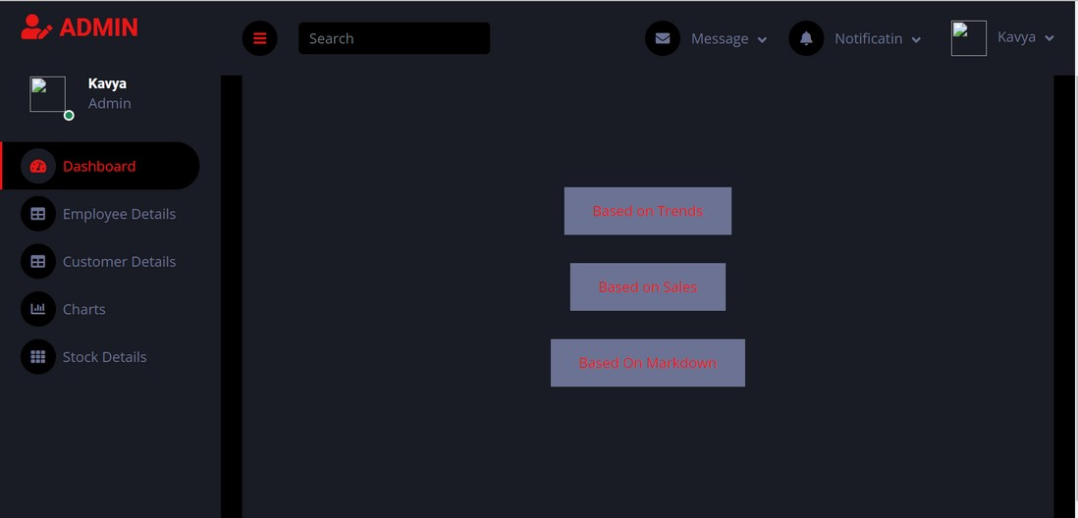
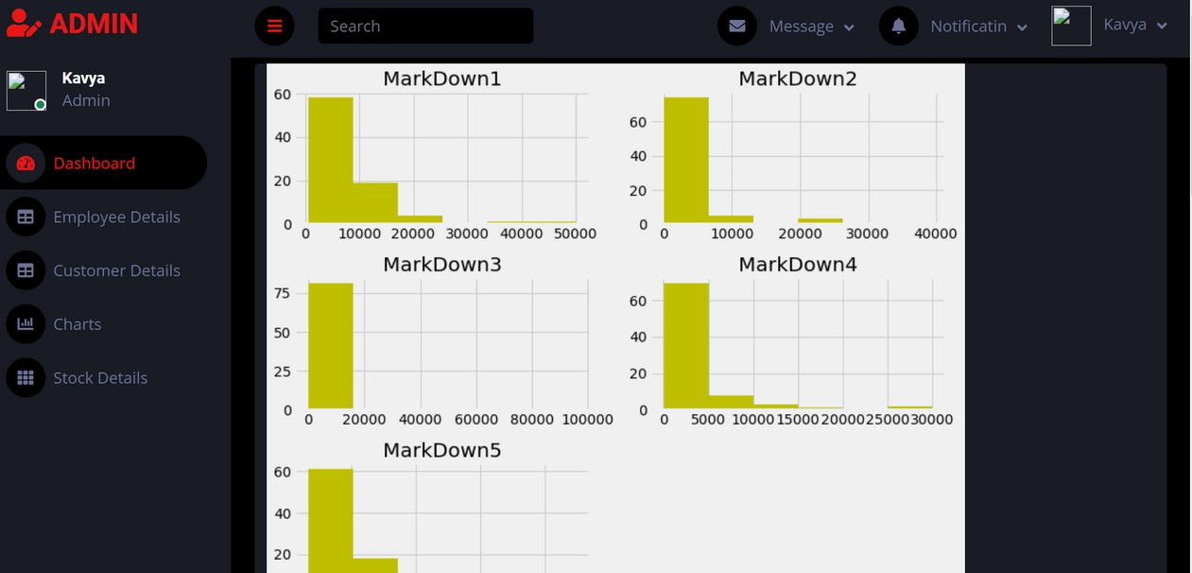

Slide 24
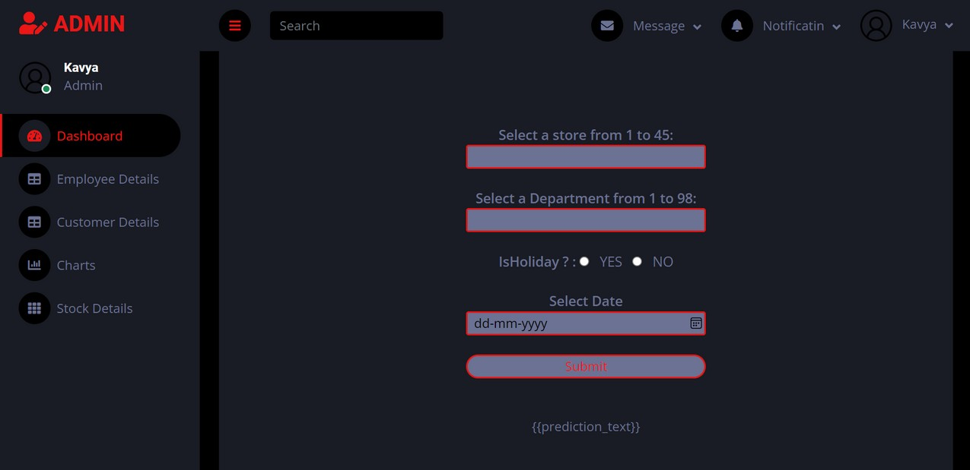
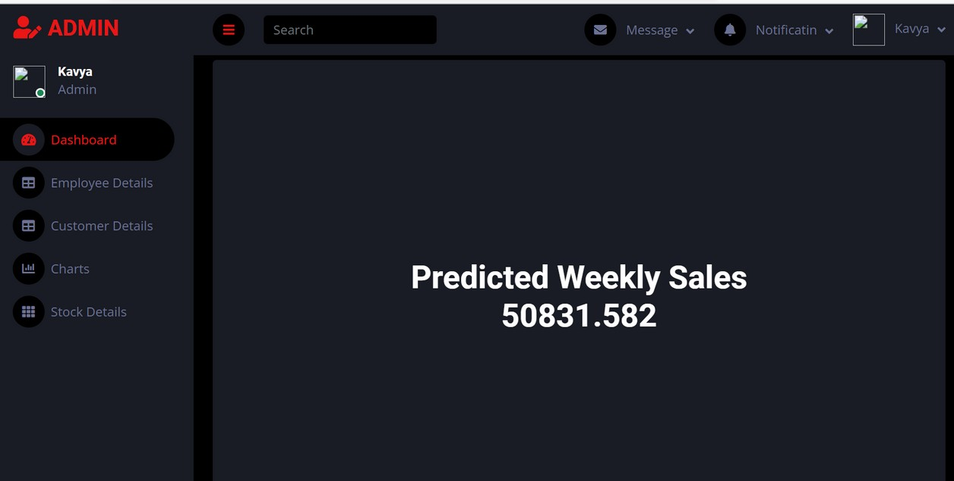

Slide 25


Ongoing Updations
authenticating using google WhatsApp log-in
website sign-in
login and

Slide 26


Comments and Questions?

Slide 27

THANK YOU

